Slide 1



DETERMINANTS OF CAR PRICE:
BEYOND ENGINE SIZE AND HORSEPOWER

Slide 2


CONTENT
02
03
01
Problem Statement
Data Cleaning process
Model Implementation

Slide 3
PROBLEM STATEMENT
What are the key determinants of car price?
and how do features such as,
Engine size,
Horsepower,
Mileage,
Curb weight influence it?

Slide 4
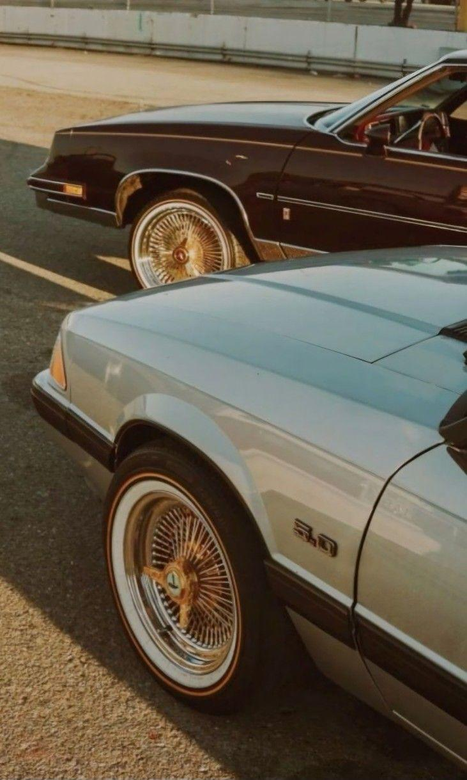


Why Projecting car prices matter
Car pricing is a major challenge for manufacturers, dealers, and buyers.
Improves pricing strategies
Understanding what features drive prices
Makes the market more transparent for consumers.
Overcome Competition

Slide 5


Dataset Overview
• Includes 26 variables
• Key variables include:
Engine size Horsepower Fuel type Mileage (city & highway MPG) Body style Drive wheels Price (target variable)

Slide 6

ANALYTICAL TECHNIQUES
The dataset was cleaned and prepared using Excel.
Key visualizations were created in Excel to explore relationships between variables.
Multiple Linear Regression was chosen as the model.

Slide 7
DATA CLEANIN PROCESS
• Handled missing values
• Categorical variables into numerical format
• Checked for invalid values
• Removed or corrected incorrect data entries

Slide 8
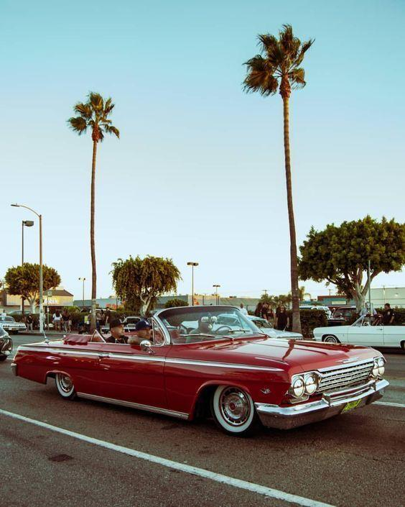

Descriptive Statistic
Calculated :
mean
Median
Minimum
Maximum & standard deviation for numerical variables
• Analysed distribution of key features • Used frequency counts for categorical variables • Helped identify outliers and data variability

Slide 9
DATA INSIGHTS
Cars with larger engine size and higher horsepower tend to be more expensive
Fuel efficiency is generally associated with lower prices
Luxury and performance brands have higher average prices
Engine size and curb weight show strong correlation with price

Slide 10
MODEL IMPLEMENTATION
Steps Taken:
• Selected price as the target variable
• Encoded categorical variables
• Scaled numerical features where required
• Split data into training and testing sets
• Trained a Multiple Linear Regression model

Slide 11



Model Evaluation
• Evaluated model using R² score and Mean Squared Error
• Training and testing performance compared
• Model shows good explanatory power for price variation
• Some prediction errors exist due to brand and market factors

Slide 12
Model Interpretation
• Engine size is the strongest predictor of price
• Horsepower significantly increases automobile value
• Higher fuel efficiency generally lowers price
• Vehicle size and weight positively affect price
• Categorical features such as brand and body style also influence pricing

Slide 13

Model Limitations
Dataset size is relatively limited
• Does not include real-time market demand
• Brand perception effects are hard to quantify
• Linear regression may not capture complex nonlinear relationships

Slide 14
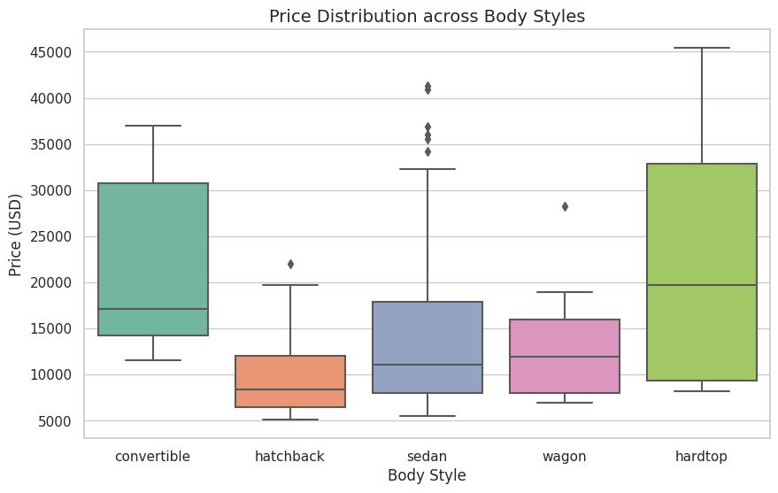
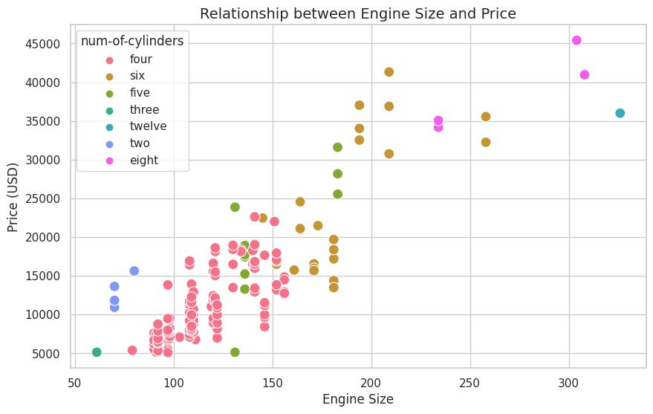
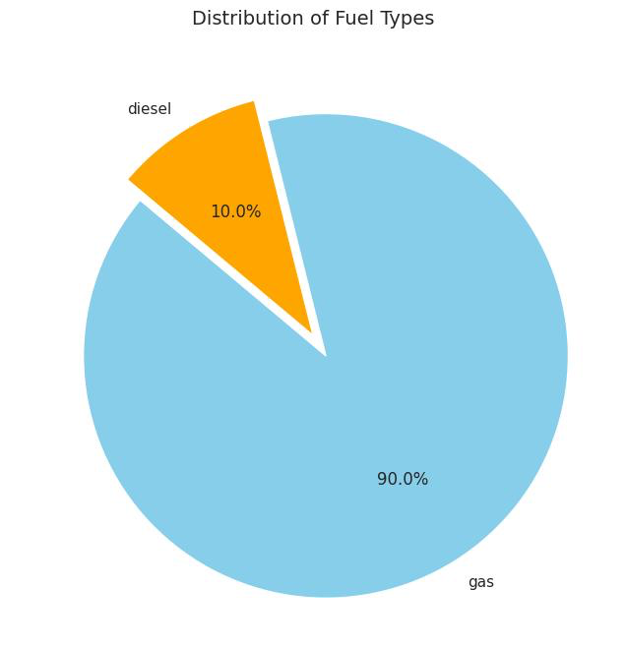
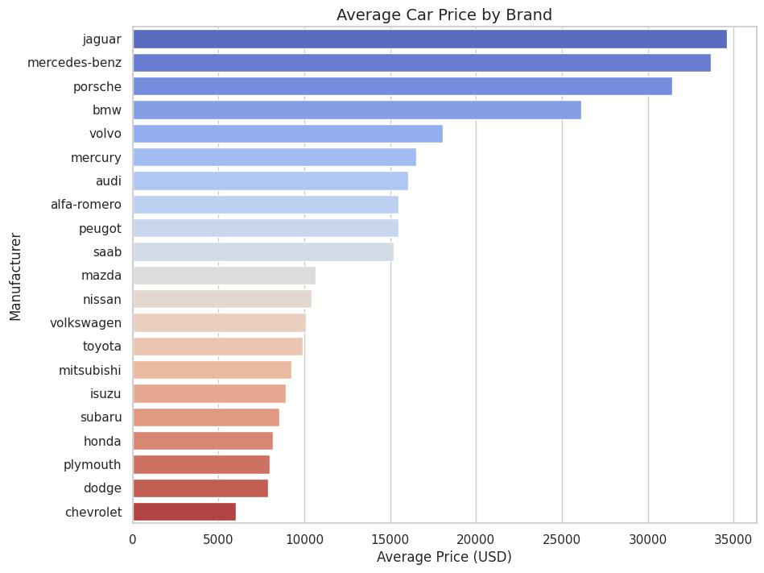
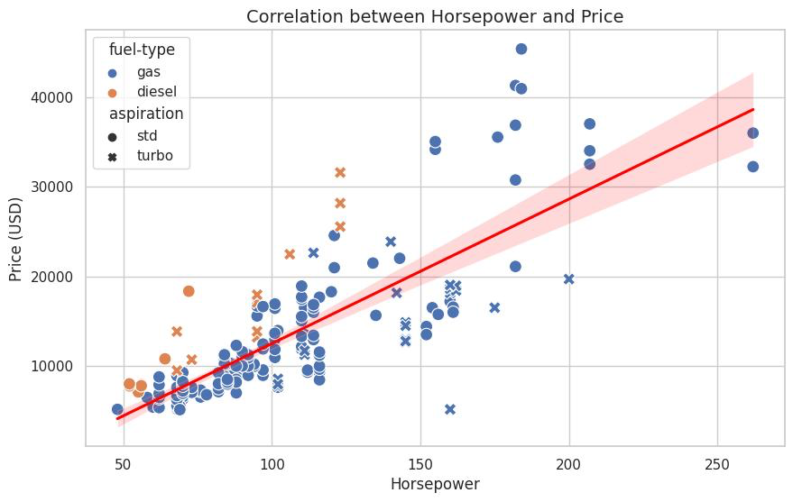

Slide 15

Conclusion
• Engine size, horsepower, and weight are the most influential factors
• Fuel efficiency has a negative relationship with price
• Linear regression provides interpretable and useful results
• The model supports better pricing and decision-making in the automotive industry

Slide 16





Future Improvements
Include brand reputation and market trends
Handle nonlinear relationships more effectively
Expand dataset for better generalization
Apply advanced models

